Slide 1


Futurion
Data Analysis
UPSKILLING INDIA
Portfoliio Project Challenge
Lung Cancer Detection
01

Slide 2
Futurion
UPSKILLING INDIA
Project Details:
Title: Lung Cancer Detection
By: Sagar Dixit
Status: Business Analyst Intern @ Iclivia
Date Of Submisson: 20/02/2025
Tools Used : Excel (For Data Manipulation),MS SQL SERVER (For Data Extraction, Power BI (For Dashboard Preparation)
04

Slide 3

Futurion
UPSKILLING INDIA
Lung Cancer Detection: Description and Business Problem with Objectives
Description:
Lung cancer is one of the most prevalent and deadliest forms of cancer worldwide. Early detection is crucial to improve survival rates and treatment outcomes, as the disease is often diagnosed in its later stages. Various methods are employed to detect lung cancer, including imaging techniques like CT scans, X-rays, and sputum tests. However, these methods are often expensive, time-consuming, and sometimes lead to false positives or negatives, which can delay treatment and increase healthcare costs.
Advancements in technology, particularly in artificial intelligence (AI) and machine learning (ML), have opened new possibilities for more accurate and efficient lung cancer detection. By analyzing large datasets from medical imaging, AI systems can help identify subtle patterns and anomalies that are not easily visible to the human eye, thus improving early diagnosis and enabling personalized treatment plans.
Business Problem:
The primary business problem is the lack of effective and efficient methods for early lung cancer detection. Current diagnostic practices often rely on manual interpretation of medical images by radiologists, which is prone to human error and subject to diagnostic delays. Moreover, the high costs of advanced imaging technology and the difficulty of ensuring timely access to specialists in some regions further exacerbate the problem.
Healthcare systems, both public and private, face the challenge of improving patient outcomes while managing rising healthcare costs. The need for a solution that provides fast, accurate, and affordable lung cancer detection is critical to address the increasing global incidence of the disease.
Objectives:
Improve Early Detection Accuracy:
Develop a system leveraging AI/ML technologies to enhance the precision of detecting lung cancer at its earliest and most treatable stages.
Reduce false positive and negative rates, ensuring more reliable results and fewer unnecessary procedures for patients.
Cost Reduction:
Create a cost-effective solution for lung cancer detection that can reduce the need for expensive and time-consuming imaging tests.
Provide healthcare providers with affordable diagnostic tools that can be integrated into routine screenings without overwhelming budgets.
3.Increase Accessibility:
Expand access to high-quality lung cancer detection, especially in underserved areas or countries with limited medical resources.
Develop solutions that can be used in a variety of settings, such as remote clinics, hospitals, or even home-based monitoring.
4.Streamline Workflow and Reduce Diagnostic Time:
Implement a faster and more efficient diagnostic process, enabling healthcare professionals to deliver quicker results and improve patient treatment timelines.
Integrate AI-powered systems into existing medical workflows to assist radiologists, reducing their workload and enhancing their productivity.
5.Drive Better Patient Outcomes:
Enhance patient survival rates by enabling early intervention and personalized treatment plans based on accurate detection.
Provide decision support tools that help healthcare providers choose the most effective treatment options for each patient, tailored to their specific condition.
05

Slide 4
Smoker
Description: Whether the individual is a smoker or not (e.g., "Yes", "No").
Type: Categorical (e.g., "Yes", "No").
Purpose: To assess the correlation between smoking habits and lung cancer risk.
Years_of_Smoking
Description: The number of years the individual has been smoking.
Type: Numeric (e.g., 20 years).
Purpose: To evaluate the relationship between the duration of smoking and lung cancer diagnosis.
Cigarettes_per_Day
Description: The average number of cigarettes smoked per day.
Type: Numeric (e.g., 10 cigarettes).
Purpose: To assess the impact of smoking intensity on lung cancer development.
Passive_Smoker
Description: Whether the individual is a passive smoker (i.e., exposed to secondhand smoke).
Type: Categorical (e.g., "Yes", "No").
Purpose: To determine if passive smoking contributes to lung cancer risk.
Family_History
Description: Whether the individual has a family history of lung cancer.
Type: Categorical (e.g., "Yes", "No").
Purpose: To evaluate the genetic predisposition to lung cancer.
Lung_Cancer_Diagnosis
Description: Whether the individual has been diagnosed with lung cancer.
Type: Categorical (e.g., "Yes", "No").
Purpose: The target variable for detection and prediction modeling, indicating whether the individual has lung cancer.
Cancer_Stage
Description: The stage of lung cancer at the time of diagnosis (e.g., Stage I, Stage II, etc.).
Type: Categorical (e.g., "Stage I", "Stage II").
Futurion
UPSKILLING INDIA
Dataset Overview: Lung Cancer and Related Factors
This dataset contains key factors related to lung cancer diagnosis, treatment, and mortality, with a focus on individual and environmental factors that influence the development and progression of the disease. It includes both demographic and lifestyle information, as well as health outcomes and exposure to risk factors. The following is an overview of each column in the dataset:
ID
Description: A unique identifier for each record in the dataset.
Type: Numeric or alphanumeric (depending on the system used).
Purpose: Used for tracking and referencing individual data entries.
Country
Description: The country of residence of the individual.
Type: String (e.g., "United States", "India").
Purpose: To understand regional variations in lung cancer risk and outcomes.
Population_Size
Description: The population size of the region or country where the individual resides.
Type: Numeric (e.g., 1,000,000).
Purpose: To contextualize the data within the broader demographic of the country or region.
Age
Description: The age of the individual.
Type: Numeric (e.g., 55).
Purpose: To assess how age influences lung cancer risk, diagnosis, and survival rates.
Gender
Description: The gender of the individual (e.g., "Male", "Female", or "Other").
Type: Categorical (e.g., "Male", "Female").
Purpose: To evaluate gender-related differences in lung cancer incidence and outcomes.
Task 02
Normalize or standardize relevant fields (e.g., age, blood counts).
06

Slide 5
Adenocarcinoma_Type
Description: Whether the individual has adenocarcinoma, a specific type of non-small cell lung cancer (NSCLC).
Type: Categorical (e.g., "Yes", "No").
Purpose: To assess the prevalence and survival outcomes for this particular type of lung cancer.
Air_Pollution_Exposure
Description: The level of exposure to air pollution in the individual's environment (e.g., low, moderate, high).
Type: Categorical (e.g., "Low", "Moderate", "High").
Purpose: To analyze how air pollution correlates with lung cancer incidence and survival.
Occupational_Exposure
Description: Whether the individual has been exposed to carcinogenic substances in the workplace (e.g., asbestos, chemicals).
Type: Categorical (e.g., "Yes", "No").
Purpose: To examine occupational risk factors contributing to lung cancer development.
Indoor_Pollution
Description: Whether the individual has been exposed to indoor air pollution (e.g., from cooking fuels, heating methods).
Type: Categorical (e.g., "Yes", "No").
Purpose: To assess how indoor air quality can impact lung cancer risk.
Healthcare_Access
Description: The level of healthcare access in the individual's region (e.g., "Good", "Moderate", "Poor").
Type: Categorical (e.g., "Good", "Moderate", "Poor").
Purpose: To evaluate the effect of healthcare availability on early diagnosis and treatment outcomes.
Early_Detection
Description: Whether the individual underwent early detection tests (e.g., screening, CT scan).
Type: Categorical (e.g., "Yes", "No").
Purpose: To assess the role of early detection in improving survival rates and outcomes.
Treatment_Type
Description: The type of treatment received by the individual (e.g.,
Developed_or_Developing
Description: Whether the individual's country is classified as developed or developing.
Type: Categorical (e.g., "Developed", "Developing").
Purpose: To evaluate how socioeconomic factors influence lung cancer prevalence and survival rates.
Annual_Lung_Cancer_Deaths
Description: The number of lung cancer-related deaths per year in the country or region.
Type: Numeric (e.g., 50,000 deaths).
Purpose: To assess the public health burden of lung cancer in different regions.
Lung_Cancer_Prevalence_Rate
Description: The prevalence rate of lung cancer in the population (e.g., percentage of the population affected).
Type: Numeric (e.g., 5%).
Purpose: To provide a measure of how widespread lung cancer is in different populations.
Mortality_Rate
Description: The mortality rate due to lung cancer in a given population, typically expressed per 100,000 individuals.
Type: Numeric (e.g., 30 per 100,000).
Purpose: To understand the severity of lung cancer as a public health issue and compare regional or national trends.

Slide 6
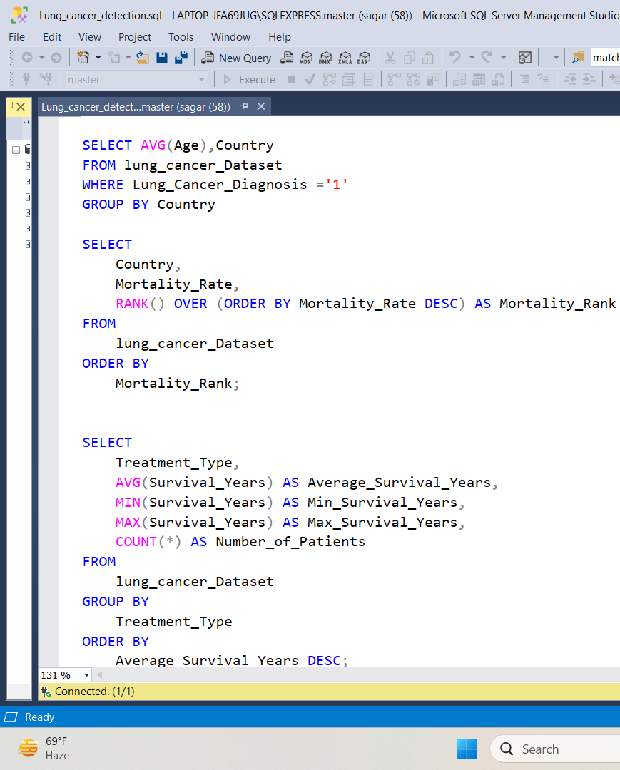
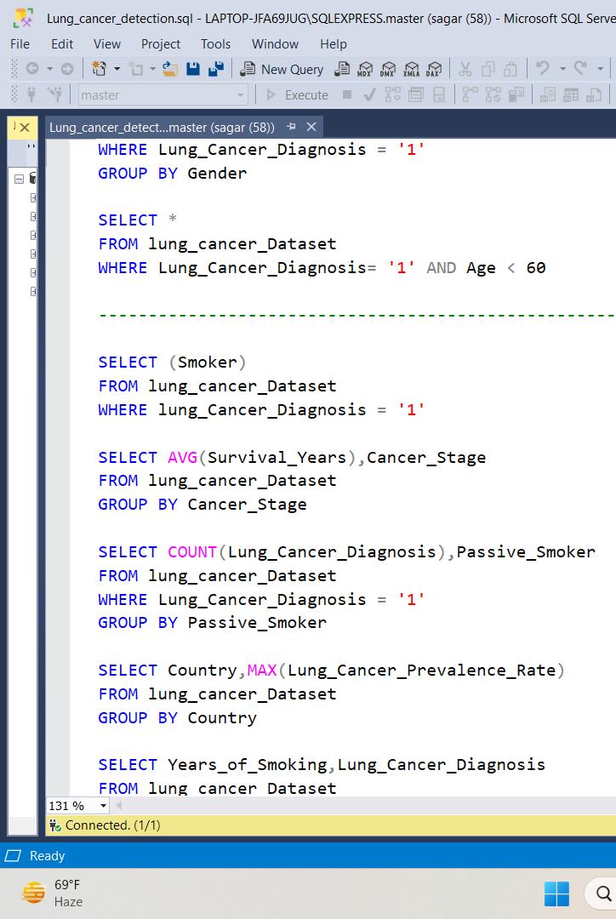
Futurion
UPSKILLING INDIA
SQL QUERIES FOR DATA EXTRACTION: (IMAGES)
07

Slide 7
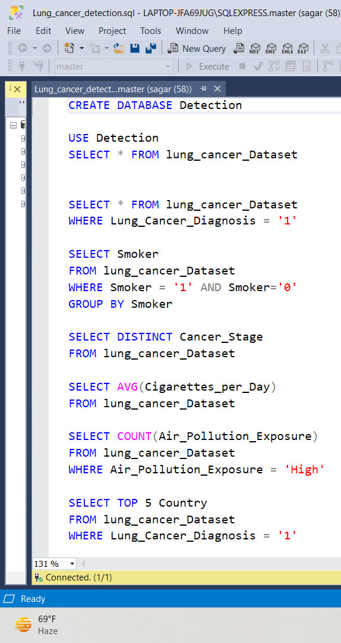

Slide 8
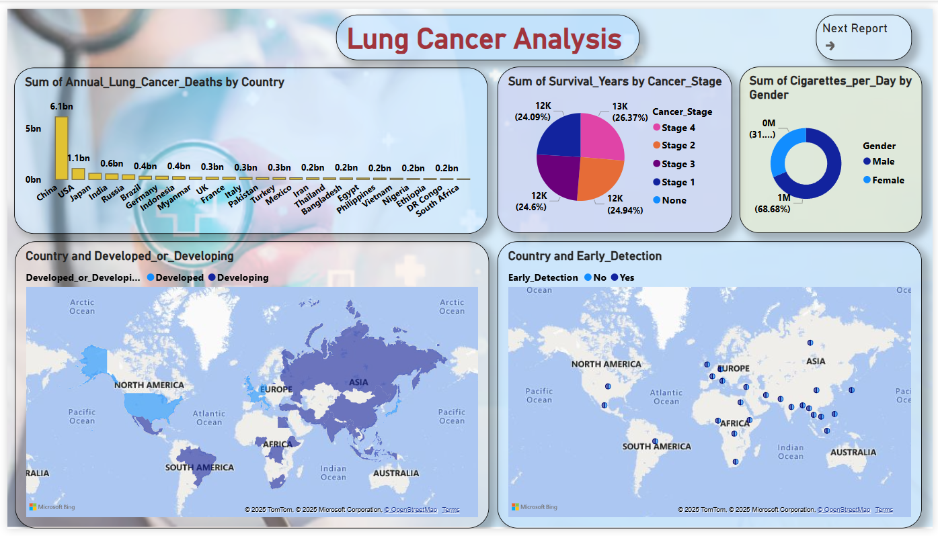
Dashboard:

Slide 9
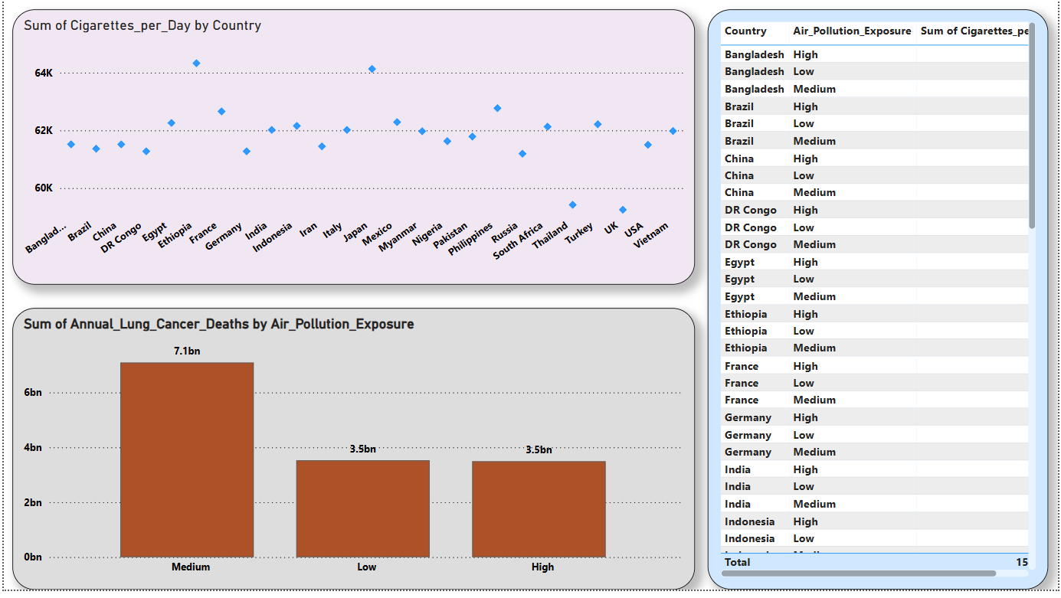

Slide 10
Key Insights From Dashboard:
From the dashboard:
Smoking and Lung Cancer Risk: By analyzing the Years_of_Smoking, Cigarettes_per_Day, and Smoker columns, you can identify correlations between smoking habits and the likelihood of a Lung Cancer Diagnosis. This can provide insights into how smoking impacts lung cancer risk across different populations.
Impact of Environmental Factors: Analyzing Air_Pollution_Exposure, Occupational_Exposure, and Indoor_Pollution can help identify regions or populations where environmental exposure is significantly contributing to lung cancer. Cross-referencing these with Lung_Cancer_Prevalence_Rate could show areas with high pollution and their link to cancer rates.
Healthcare Access and Early Detection: By comparing Healthcare_Access and Early_Detection with Lung_Cancer_Diagnosis and Cancer_Stage, you could uncover disparities in diagnosis times and survival outcomes, especially in Developed vs. Developing countries.
Gender and Age Correlation: The Gender and Age columns can highlight trends related to gender and age-specific lung cancer diagnosis, as well as survival rates (Survival_Years) and Cancer_Stage at diagnosis. This can identify vulnerable age groups or gender-specific risk factors.
Lung Cancer Mortality and Prevalence: Analyzing the relationship between Annual_Lung_Cancer_Deaths, Lung_Cancer_Prevalence_Rate, and Mortality_Rate can give a clear picture of how effective prevention, early detection, and treatment are in reducing mortality. This could help guide healthcare policies or public health initiatives.

Slide 11
Business Recommendations:
Targeted Anti-Smoking Campaigns: Launch targeted smoking cessation programs, especially for high-risk demographics (e.g., long-term smokers, younger adults) to reduce smoking-related lung cancer. Collaborating with governments or healthcare providers in high-prevalence regions would be beneficial.
Increase Investment in Environmental Health: Invest in pollution control technologies and advocate for stricter regulations on industrial emissions and air quality. Businesses in industries like manufacturing or energy could offer solutions for cleaner technologies, benefiting both public health and corporate sustainability.
Expand Early Detection and Healthcare Access: Partner with healthcare providers and government bodies to improve access to early detection services, particularly in underserved or developing areas. Offering mobile health screening or telemedicine services could improve early-stage diagnosis and survival rates.
Develop Age-Specific Prevention and Treatment Programs: Design prevention, treatment, and awareness programs tailored to specific age groups or genders. For instance, older adults may require different screening methods or treatment protocols. Gender-specific risk assessments could further enhance personalized healthcare services.
Support Health Initiatives in Developing Countries: Partner with global health organizations to bring lung cancer awareness and early detection programs to developing countries. Providing affordable diagnostic tools or supporting local healthcare infrastructure could reduce mortality rates in these regions.
Conclusion And Business Recommendation:
Conclusions:
Smoking Remains a Primary Risk Factor: Smoking continues to be a significant contributor to lung cancer, especially among long-term smokers. The data likely shows a strong link between smoking habits (e.g., years of smoking, cigarettes per day) and lung cancer diagnosis.
Environmental and Occupational Exposure is High-Risk: Areas with high levels of air pollution, occupational exposure, and indoor pollution appear to have higher rates of lung cancer. This suggests that environmental factors are playing a crucial role in the prevalence of the disease.
Access to Healthcare Affects Diagnosis and Survival Rates: Regions with better healthcare access and early detection programs have higher survival rates. Conversely, areas with poor access may show more advanced stages of cancer at diagnosis, affecting overall survival.
Age and Gender Influence Outcomes: Age and gender are likely playing significant roles in lung cancer diagnosis and survival. Certain age groups and genders may be more susceptible to severe stages of cancer at the time of diagnosis, and may experience different survival outcomes.
Lung Cancer Mortality and Prevalence Are High in Developing Countries: Developing countries may show higher mortality rates, possibly due to a combination of delayed diagnoses, inadequate healthcare infrastructure, and limited early detection initiatives.

